Slide 1


GENERIC DATAGRID APP WITH AG GRID & REACT MUI
BMW IT Internship Aptitude Test
Samiya Batool

Slide 2
AGENDA
Problem & Goals
Tech Stack
Project Structure
Front-End Components
Back-End & Database
Challenges & Learnings
Links

Slide 3
TECH STACK
Build Tool: Vite
Front-End: React.js + TypeScript + AG Grid React + MUI
State/HTTP: Axios
Back-End: Node.js + Express.js + TypeScript
Database: MongoDB Atlas

Slide 4
PROBLEMS & GOALS
Need: Flexible UI for any tabular data
Goals:
Reusable, generic DataGrid component
Backend-driven search & filter
CRUD via REST API
NoSQL persistence

Slide 5
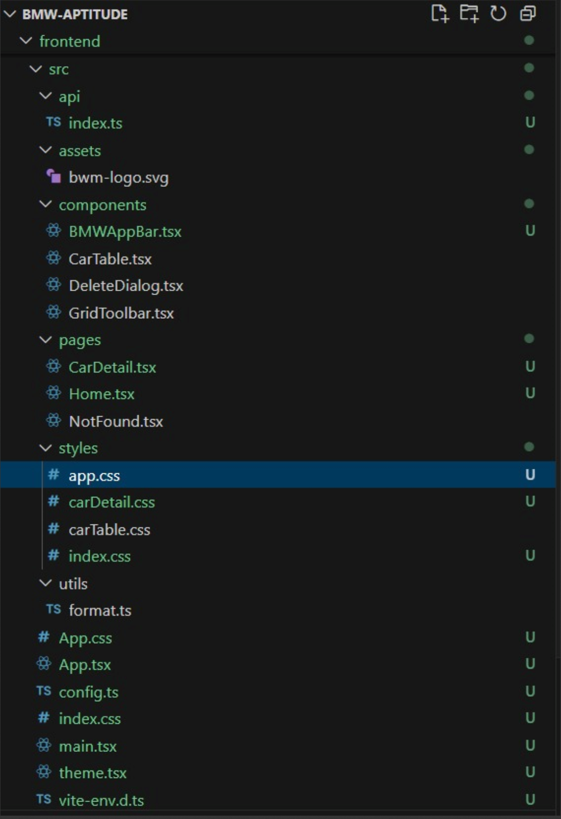
PROJECT STRUCTURE
Front-End

Slide 6
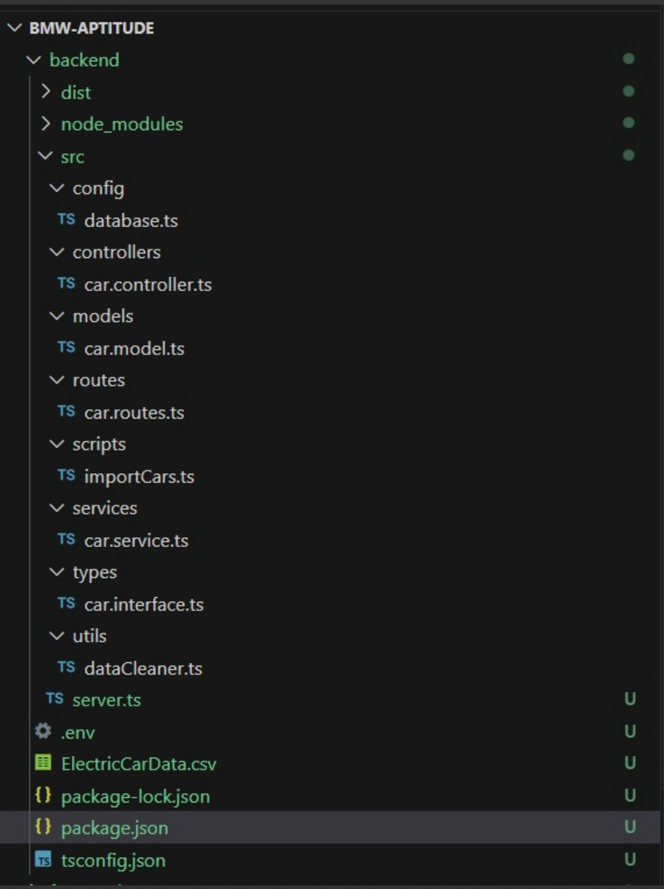
PROJECT STRUCTURE
Back-End

Slide 7
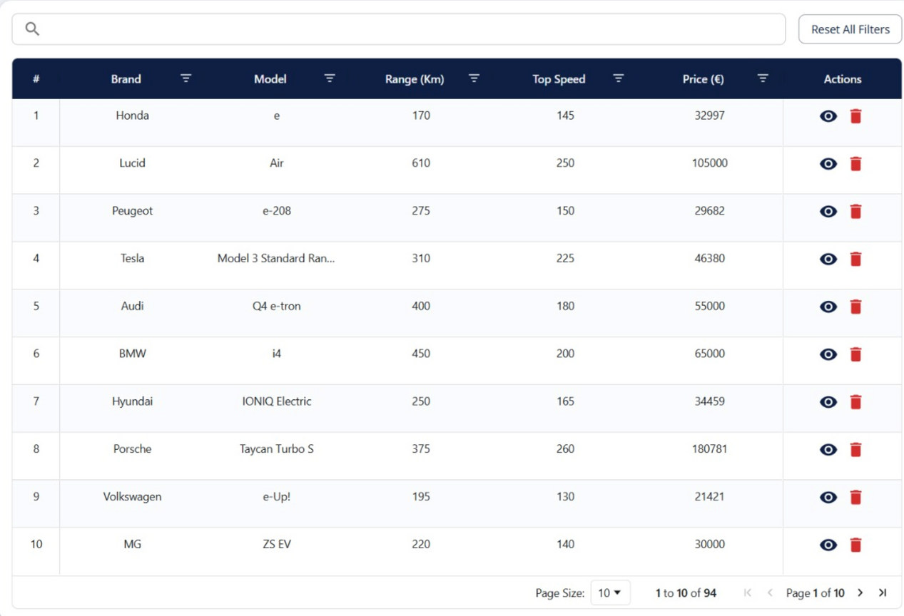
FRONT-END COMPONENTS
• Generic DataGrid
–Dynamic columns & row
data
–Default “Actions” column
(View, Delete)
–Props for extra buttons
• Detail View
–Navigates on “View”
–Back button to grid
Delete → Removes Row
View → Detail Page

Slide 8
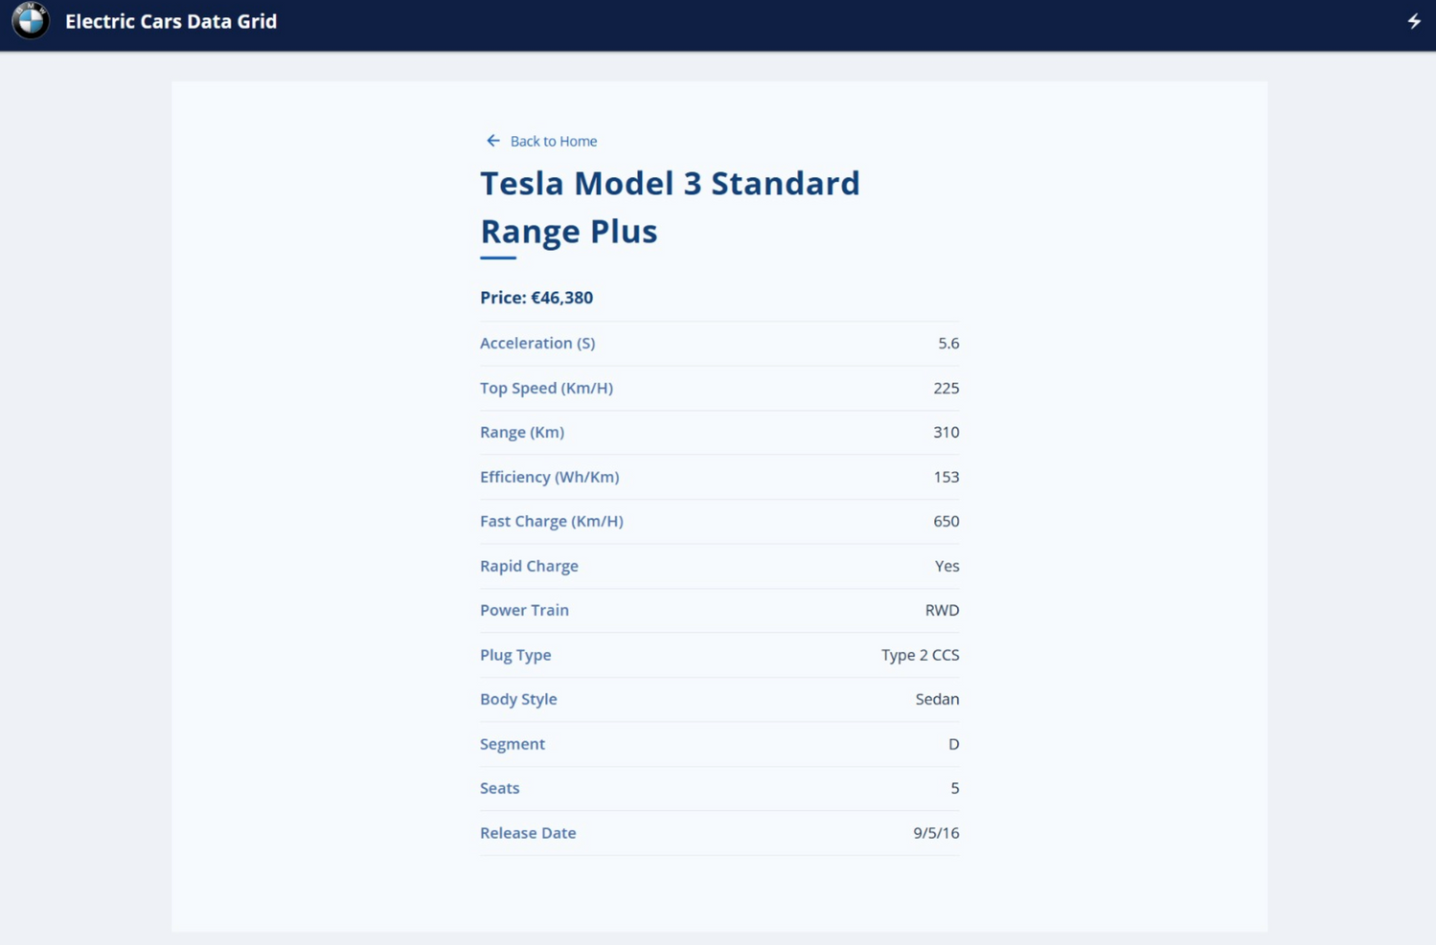
FRONT-END COMPONENTS
Detail Page

Slide 9
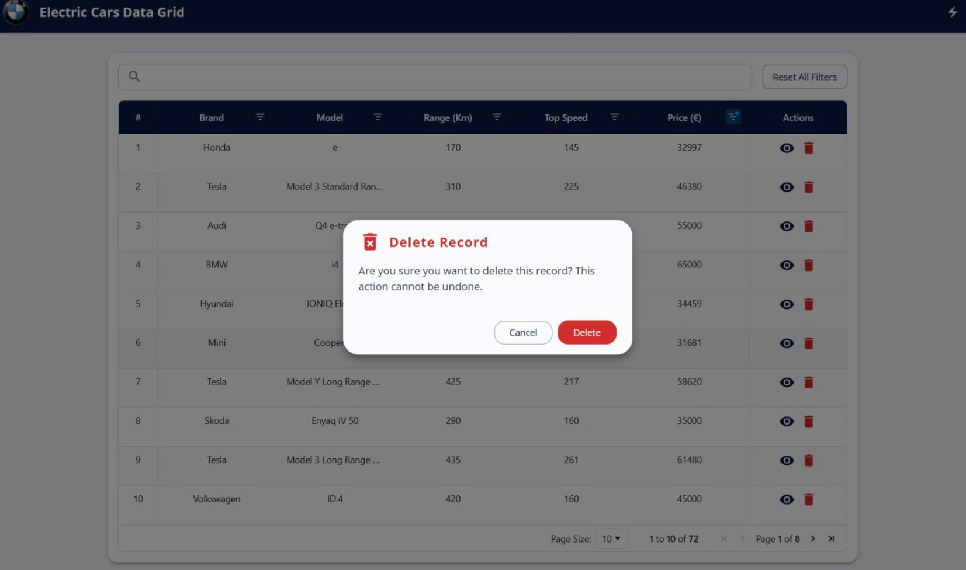
FRONT-END COMPONENTS
Delete Action

Slide 10
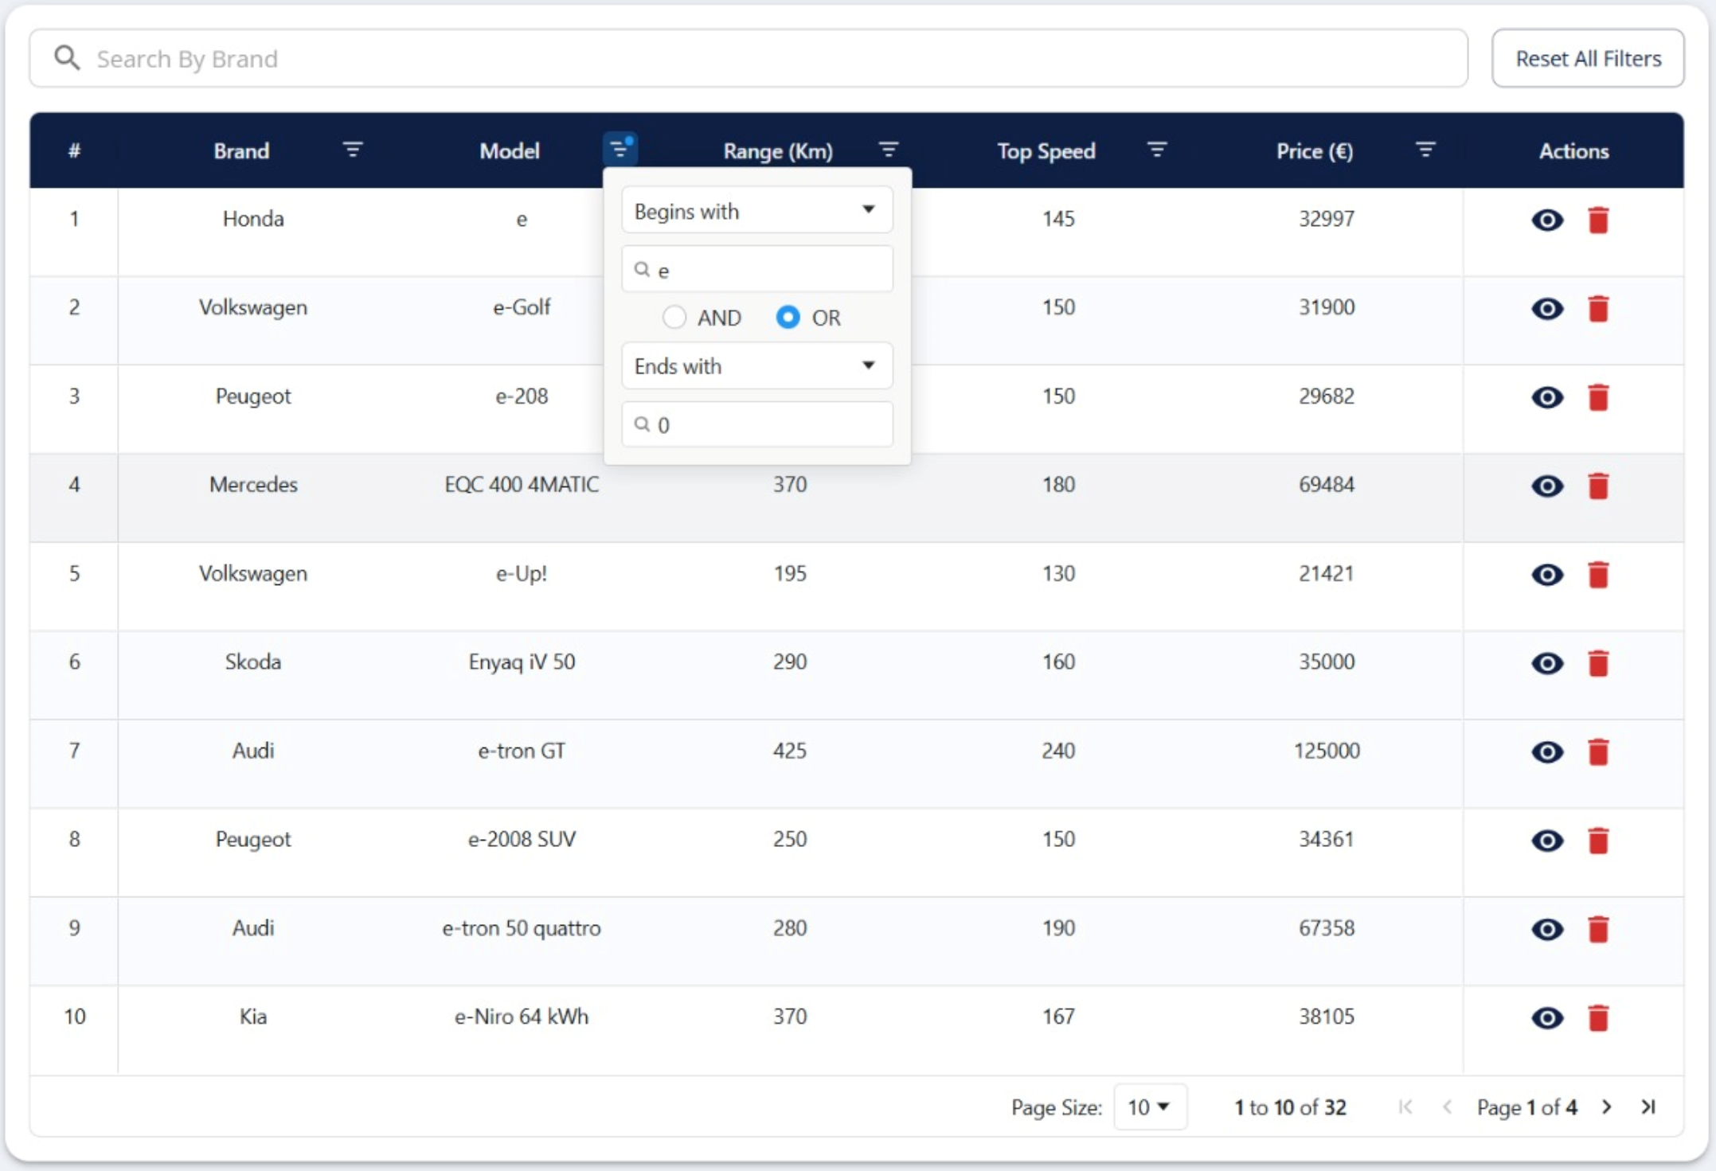
SEARCH & FILTER
Begins with ‘e’ OR ends with ‘0’

Slide 11
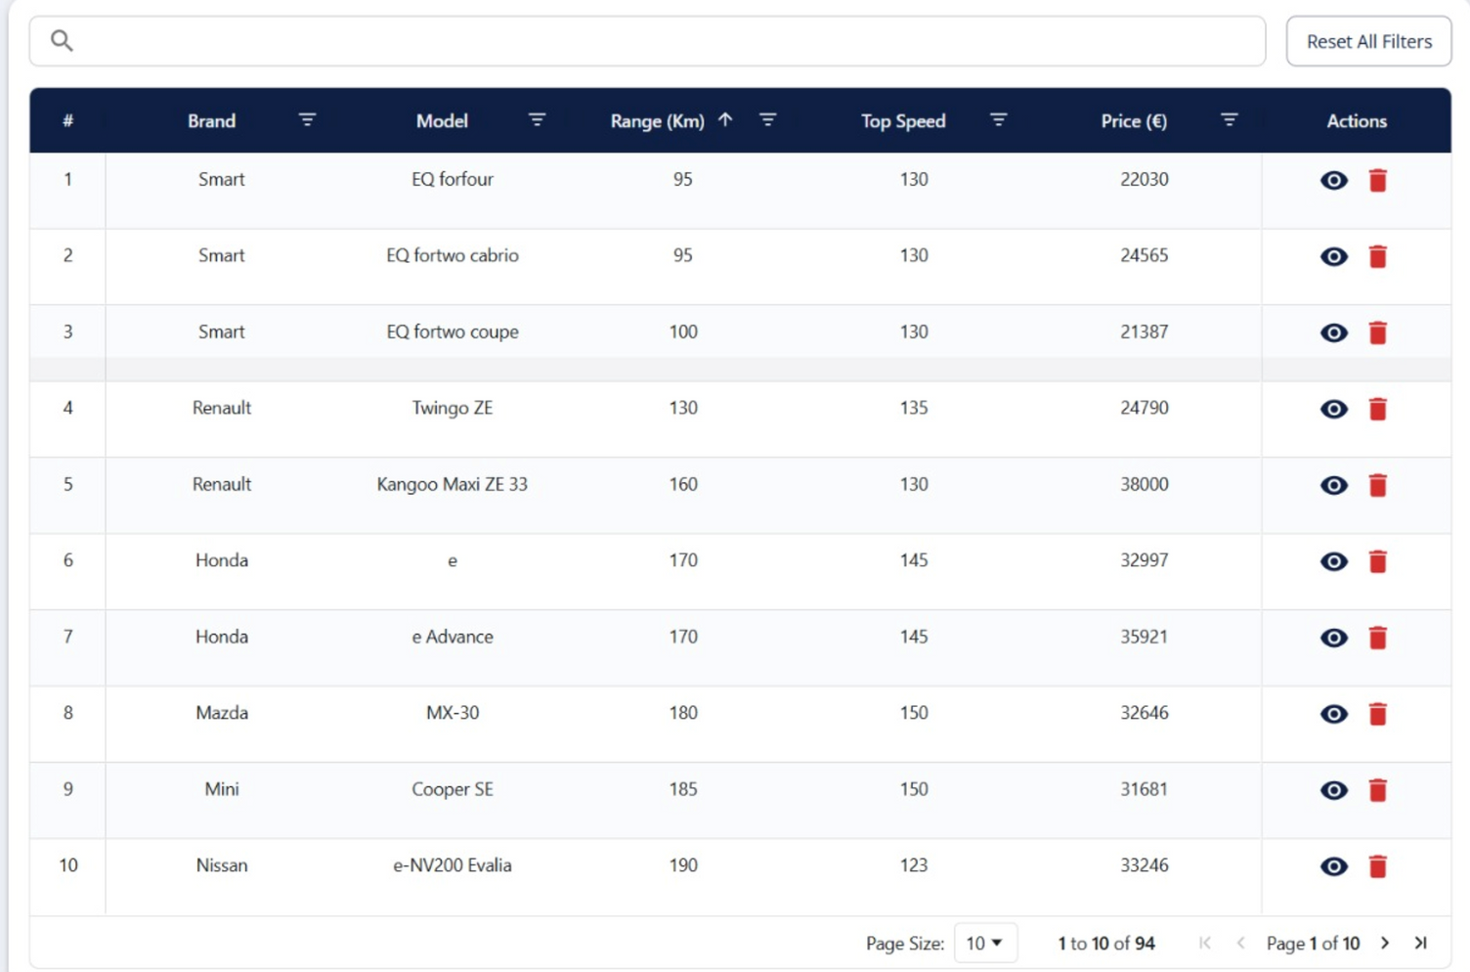
SEARCH & FILTER
Grid sorted in
ascending order
with respect to
range.

Slide 12
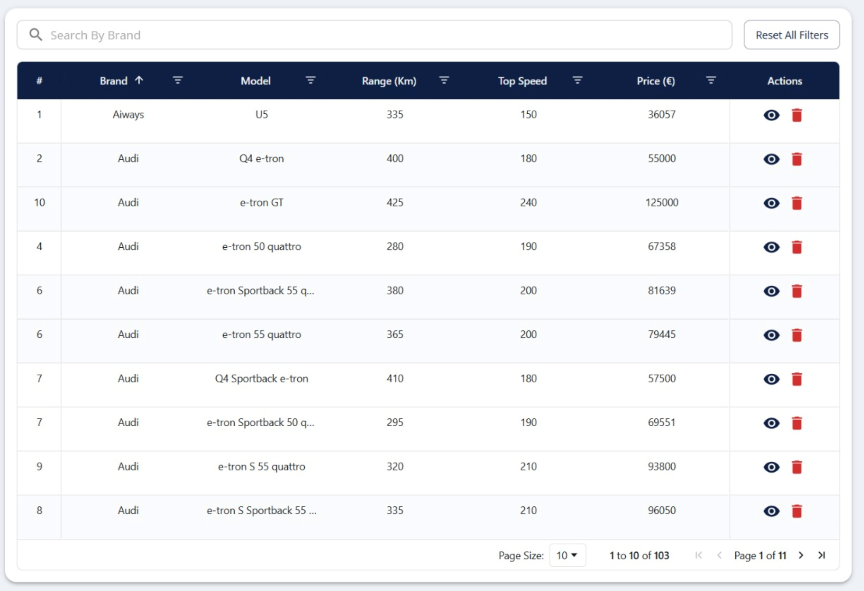
SEARCH & FILTER
Brand column
sorted
Alphabetically

Slide 13
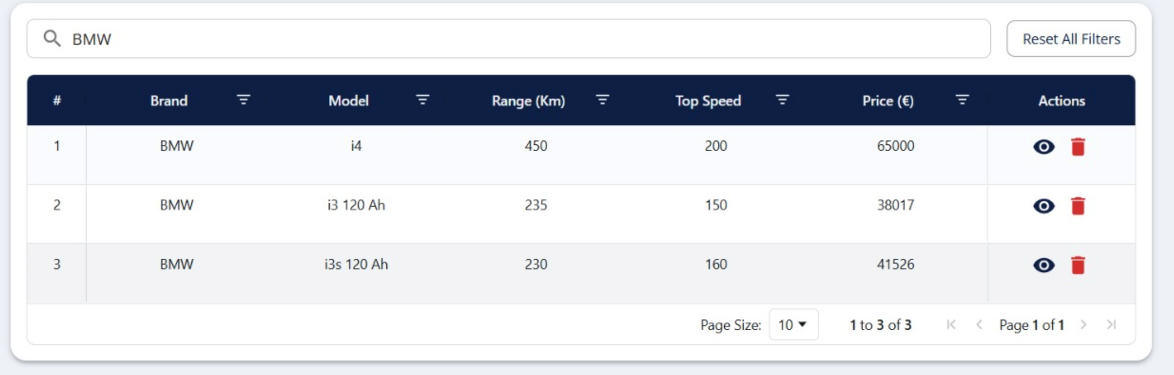
SEARCH & FILTER
Search result for ‘BMW’

Slide 14
BACK-END & DATABASE
• Express.js REST API
– GET /api/cars - Get all cars record
– GET /api/cars/:id - Get car by id
– DELETE /api/cars/:id - Delete car by id
– POST /api/cars/search - Search and filter cars
• MongoDB Atlas
– Cloud-hosted NoSQL
– Flexible schema & indexing

Slide 15
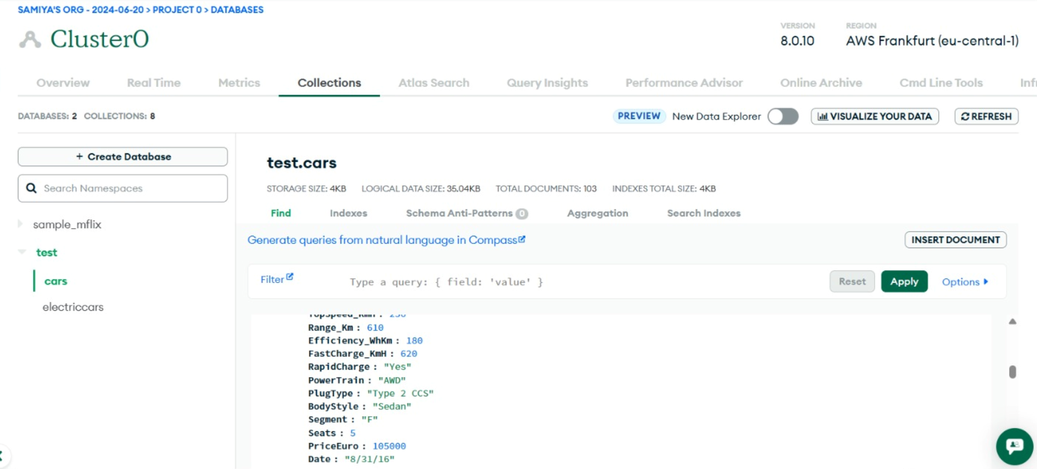
BACK-END & DATABASE

Slide 16
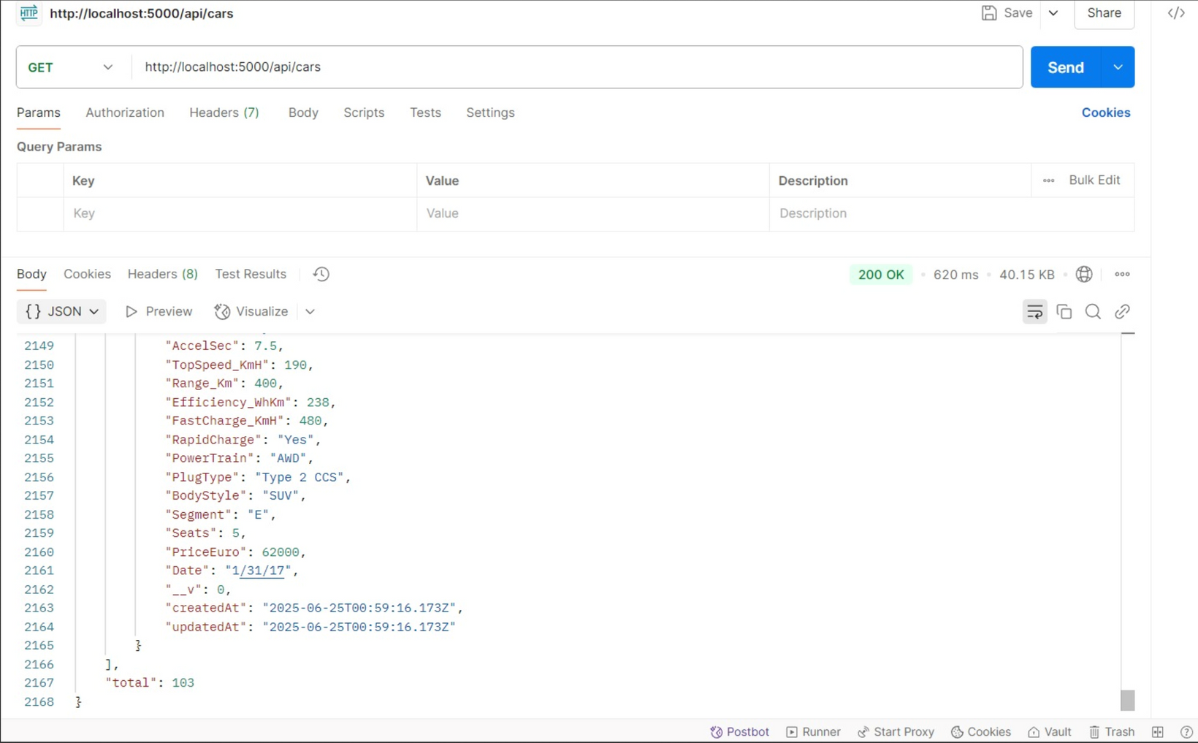
BACK-END & DATABASE

Slide 17
CHALLENGES & LEARNINGS
Integrated AG Grid with React and MUI for a flexible, modern UI.
Ensured smooth data flow and type safety across frontend and backend.
Handled and cleaned inconsistent CSV data for robust imports.
Designed a scalable, reusable project structure for maintainability.

Slide 18
LINKS
Github Repository
LinkedIn

Slide 19
THANK
YOU

